Slide 1
AI-Based Emotion Recognition & Mental Health Monitoring
presented by : Fluffy Debuggers (T7)

Slide 2
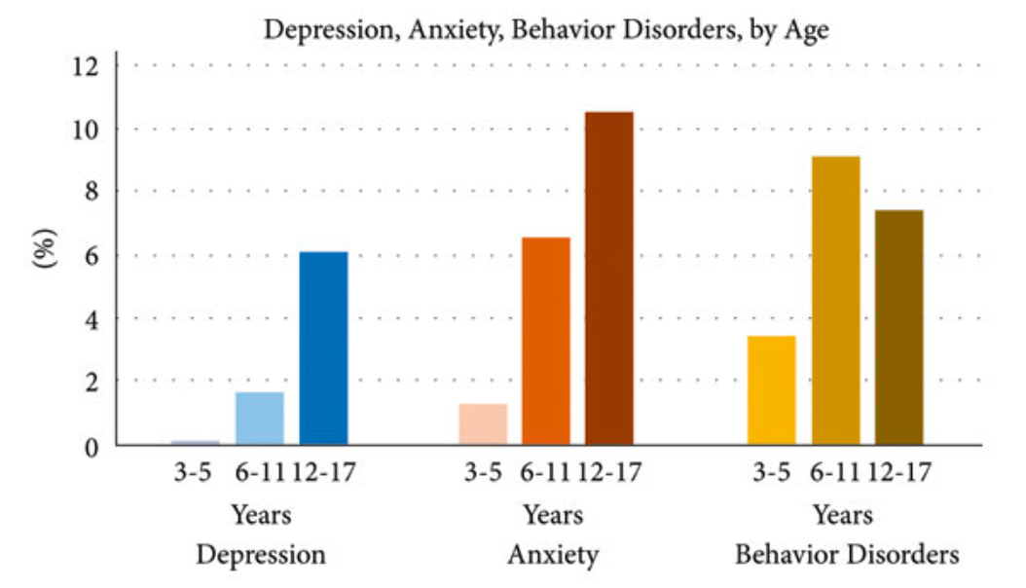
Problem statement
Mental health issues are growing worldwide, butreal-time monitoring of patient emotions during therapy or online interactions is limited. Therapists, educators, and customer support professionals need tools to better understand user emotions beyond words

Slide 3
GOAL & SCOPE
Goal:- Develop an AI-powered system that combines facial expression recognition and speech sentiment analysis to detect and track emotions in real-time. The system provides analytics via a secure cloud dashboard for therapists and organizations.
Scope:
In-scope: Emotion recognition (face + voice), multimodal fusion, cloud dashboard, alerts.
Out-of-scope: Therapy recommendations, hospital-scale deployment.

Slide 4
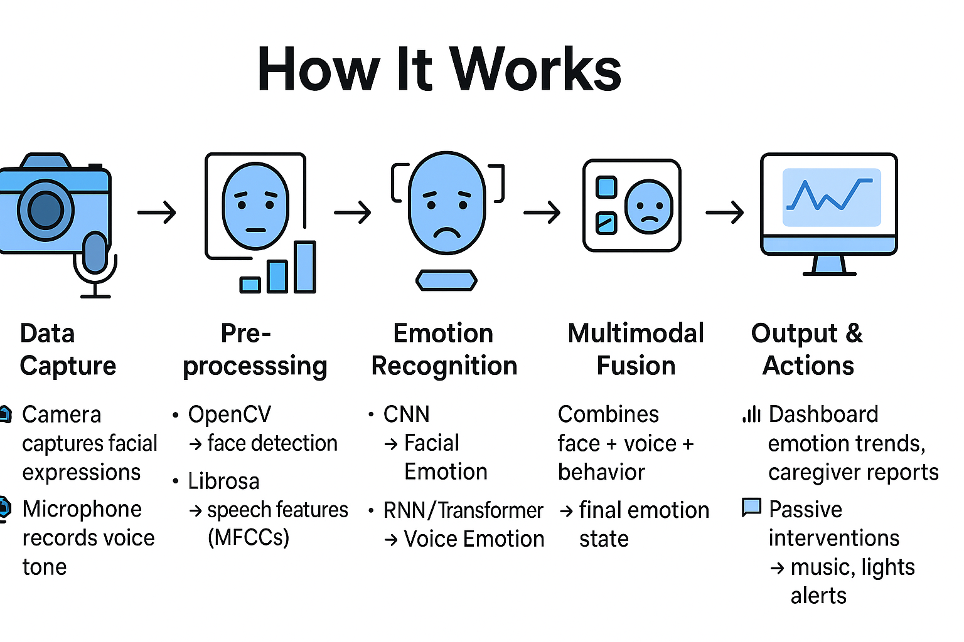

Slide 5
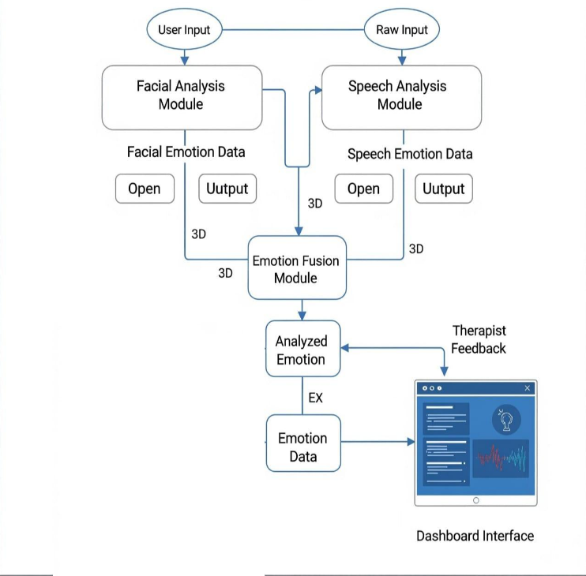
Workflow Diagram

Slide 6
Technical Approach
Data Collection & Preprocessing
Datasets: FER-2013 (faces), RAVDESS (voice)
Tools: OpenCV (face detection), Librosa (MFCC extraction), signal filtering
Model Development
CNN → Facial emotion recognition
1D CNN→ Voice-based emotion detection
Fusion Layer → Combine outputs for higher accuracy
Advanced Techniques
Multimodal Emotion Fusion (face + voice )
Emotion Trajectory Tracking (monitor trends over time)
Few-Shot Personalization (adapt to individual patterns)
System Integration
Backend: Flask for inference services
Database: SQL/MongoDB for emotion logs (encrypted)
Dashboard: React with charts, and reports

Slide 7
Market Analysis
Mental Health Market Trends
Global mental health tech market projected to reach $15B+ by 2030.
Increased demand for AI-powered emotional health tools in therapy, education, and workplaces.
Rising adoption of teletherapy & digital well-being platforms

Slide 8
Market Landscape and Competitive Differentiation
Competitor | Product | Target Users | Key Features | Strengths | Weaknesses | Our Differentiator
Woebot | Mental Health Chatbot | General Users | Text-based CBT chatbot | Engaging chatbot | No multi-modal emotion detection | Real-time facial & voice emotion detection
Wysa | AI Companion | Students, Employees | Chat, journaling | Popular in India | Limited AI depth | Real-time multimodal analysis
Fitbit | Stress App | Fitness Users | HR-based stress tracking | Hardware-backed | No facial/voice data | Multi-source fusion of face, voice

Slide 9
Uniqueness & Innovation in Objectives & Key Features
Unique Objectives
Category-Specific Care →
Normal users: Music/ambient soothing
Moderate users: Depression tracking & alerts
Mentally ill: Clinically relevant reports & caregiver dashboards
Context-Aware Emotion AI → Includes time, environment & personal routines
Privacy-First Design → Edge inference, encrypted logs, consent-first
Innovative Key Features
Multimodal Emotion Fusion → Combines face and voice emotions
Real-Time Monitoring → ≤5s latency, works in therapy/education
Emotion Trajectory Tracking → Detects long-term mood swings
Few-Shot Personalization → Learns user patterns with minimal data
Passive Intervention System → Music
Clinically Relevant Insights → Stress index, anomaly detection, weekly reports

Slide 10
Weekly Timeline
Week 1 | Requirements & datasets
Week 2 | Literature survey & architecture
Week 3 | Facial emotion recognition
Week 4 | Speech emotion recognition
Week 5 | Fusion model
Week 6 | Dashboard development
Week 7 | Testing
Week 8 | Deployment & presentation

Slide 11
Team contributions
Name | Role | responsibility
Priyam Kumar | Lead/ML/DL | Architecture, coordination, tracking, Facial & speech model, Multimodal Fusion
Nakul Upadhyay | Frontend | React UI
Piyush Maurya | Backend | Cloud, DB, security

Slide 12
Thank you

